Slide 1

Pandemic Planning for Your Workplace
Next Wave

Slide 2
Re-boarding Your People to Your Real Workplace

Slide 3
Return to Work
How Do We Get It Done?

Slide 4
Return to Work
How Do We Get It Done:
How to Build Your Action Plan for
Return to Work.

Slide 5
How to Build Your Action
Plan for RTW
Platform for planning + training

Slide 6
How to Build Your Action
Plan for RTW
Platform for planning + training
Create a RTW Plan

Slide 7
How to Build Your Action
Plan for RTW
Platform for planning + training
Create a RTW Plan
Employee Training

Slide 8
How to Build Your Action
Plan for RTW
Platform for planning +
training
Create a RTW Plan
Employee Training
First Day Back

Slide 9
How to Build Your Action
Plan for RTW
Platform for
planning + training
Create a RTW Plan
Employee Training
First Day Back

Slide 10
Today’s Goal
We Can’t Write Your Plan for
You in This Presentation

Slide 11
Today’s Goal
We Can Define
the Process for
Your Planning +
Training

Slide 12
Today’s Goal
Only You Can Create Your Plan + Train Your
Employees

Slide 13
Today’s Goal
Only You Can Create
Your Plan + Train Your Employees:
Site Specific

Slide 14
Today’s Goal
That Complies
w. Best Practices, Laws, Regulations + Standards

Slide 15
Today’s Goal
Leaders
Protect Their Employees

Slide 16
Today’s Goal
Build Authority + Confidence Employees, Directors, Customers

Slide 17
Today’s Goal
How Do We Get It Done:
How to Build Your Action Plan for
Return to Work.

Slide 18
Today’s Goal
8 Emps
or 8,000
“How Do We Get It Done:
How to Build Your Action Plan for
Return to Work.”

Slide 19
For Every Complex Problem…

Slide 20
For Every Complex Problem,
There’s a Simple Solution

Slide 21
For Every Complex
Problem, There’s a Simple Solution
That’s Always Wrong

Slide 22
Fair
Warning

Slide 23
Fair Warning!!!
I Will Be
Candid
★    

Slide 24


Slide 25
Bo Mitchell
President
911 Consulting

Slide 26


Slide 27
  Police Commissioner (Ret.)
Certified Homeland Security
CEM, CPP, CHS-V, CBCP, CSI-ML, HSEEP, CNTA, IAC, MOAB, CHSP, CHEP, CSHM, CESCO, CHCM, CFC, CSSM, CSC, CAS, TFCT3, CERT, CHSEMR, CMC

Slide 28
Expert Consultant
Landmark Legal
Cases
Expected
Settlements:
$1 Billion Each

Slide 29
Expert Consultant
Landmark Legal
Cases
Expected
Settlements:
$1 Billion Each
“Failure to Plan”
“Failure to Train”

Slide 30
911 Consulting Clients
    GE HQ
    H&R Block HQ
    Hyatt HQ
    MasterCard HQ
    Rolls Royce HQ
    Subway HQ

Slide 31
911 Consulting Clients
5 Colleges &
Universities
26 Secondary

Slide 32
How
Long Will COVID19 Last?

Slide 33
We Have a Precident

Slide 34
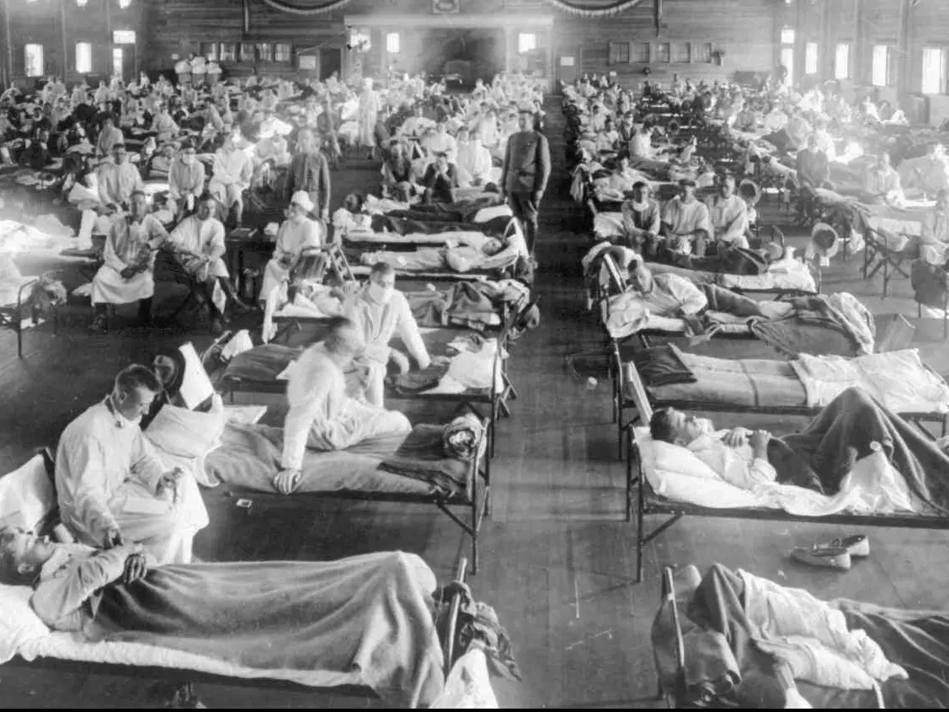
1918-1920 Pandemic

Slide 35
Dead Americans
650,000
1918-1920 Pandemic

Slide 36

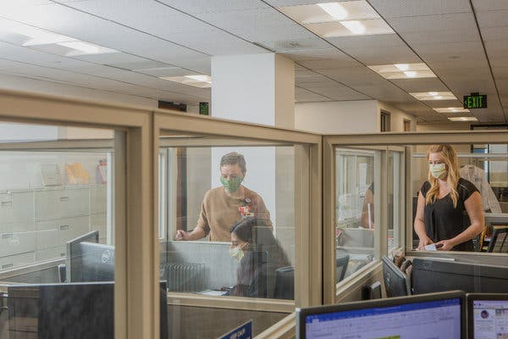

Slide 38

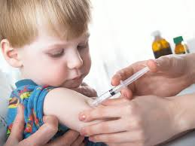

Slide 39
330,000 Americans
330,000
Americans

Slide 40
330,000 Americans
330,000
Americans
X2

Slide 41
Xmas
2021

Slide 42
For Every Complex
Problem, There’s a Simple
Solution
That’s Always Wrong

Slide 43

WFH
“Send ‘em Home. Perfect!”

Slide 44

“They’ll Be Fine”
WFH

Slide 45

WFH
“What Could Go Wrong?”

Slide 46
WFH
Not Simple
Complicated

Slide 47
RTW
Not Simple
Complicated

Slide 48


Slide 49
What
Does RTW Look Like?

Slide 50
How
Can We Do
This Safely?

Slide 51
Standards

Slide 52









Slide 53
Standards
= Platform

Slide 54
Today’s Goal
Leaders
Protect Their Employees

Slide 55
Today’s Goal
Build Authority Trust + Confidence: Employees, Directors, Customers

Slide 56
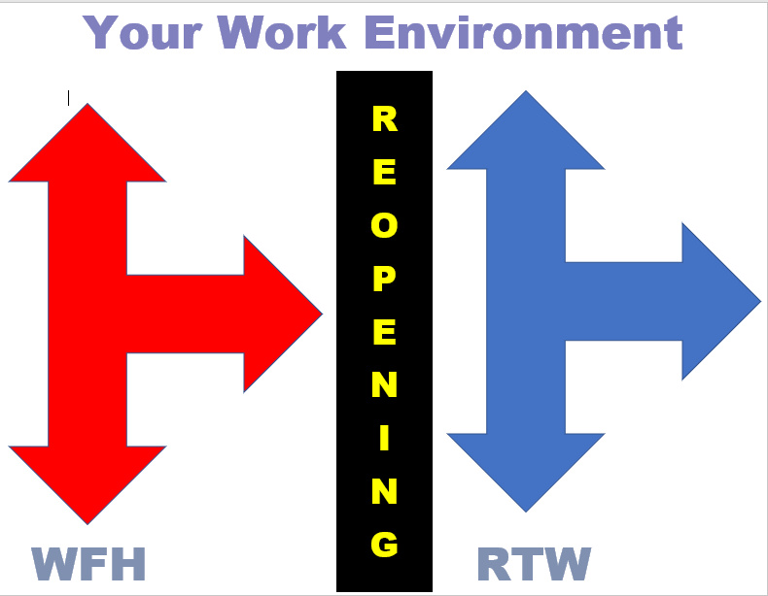
RTW

Slide 57

RTW

Slide 58

RTW

Slide 59
100%

Slide 60
25%
50%
75%
100%

Slide 63
6 Mos

Slide 64
6Mos? 12Mos?

Slide 65
6 Mos? 12Mos? 18Mos?

Slide 66
RTW

Slide 67
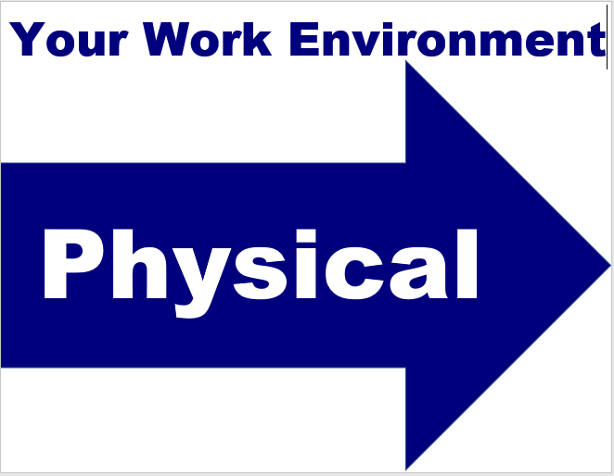

Slide 68
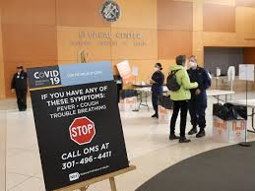

Slide 69
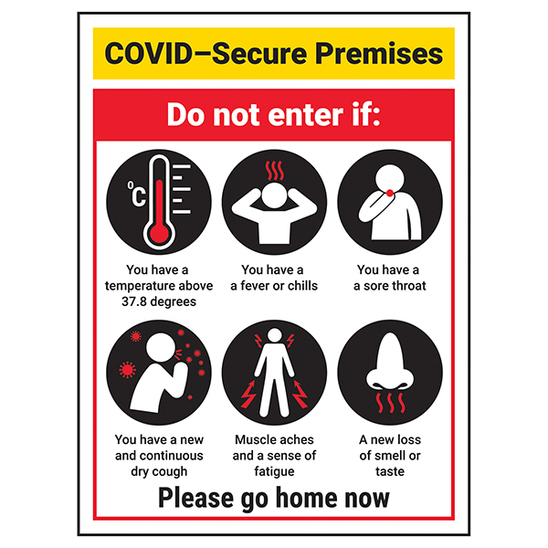

Slide 70
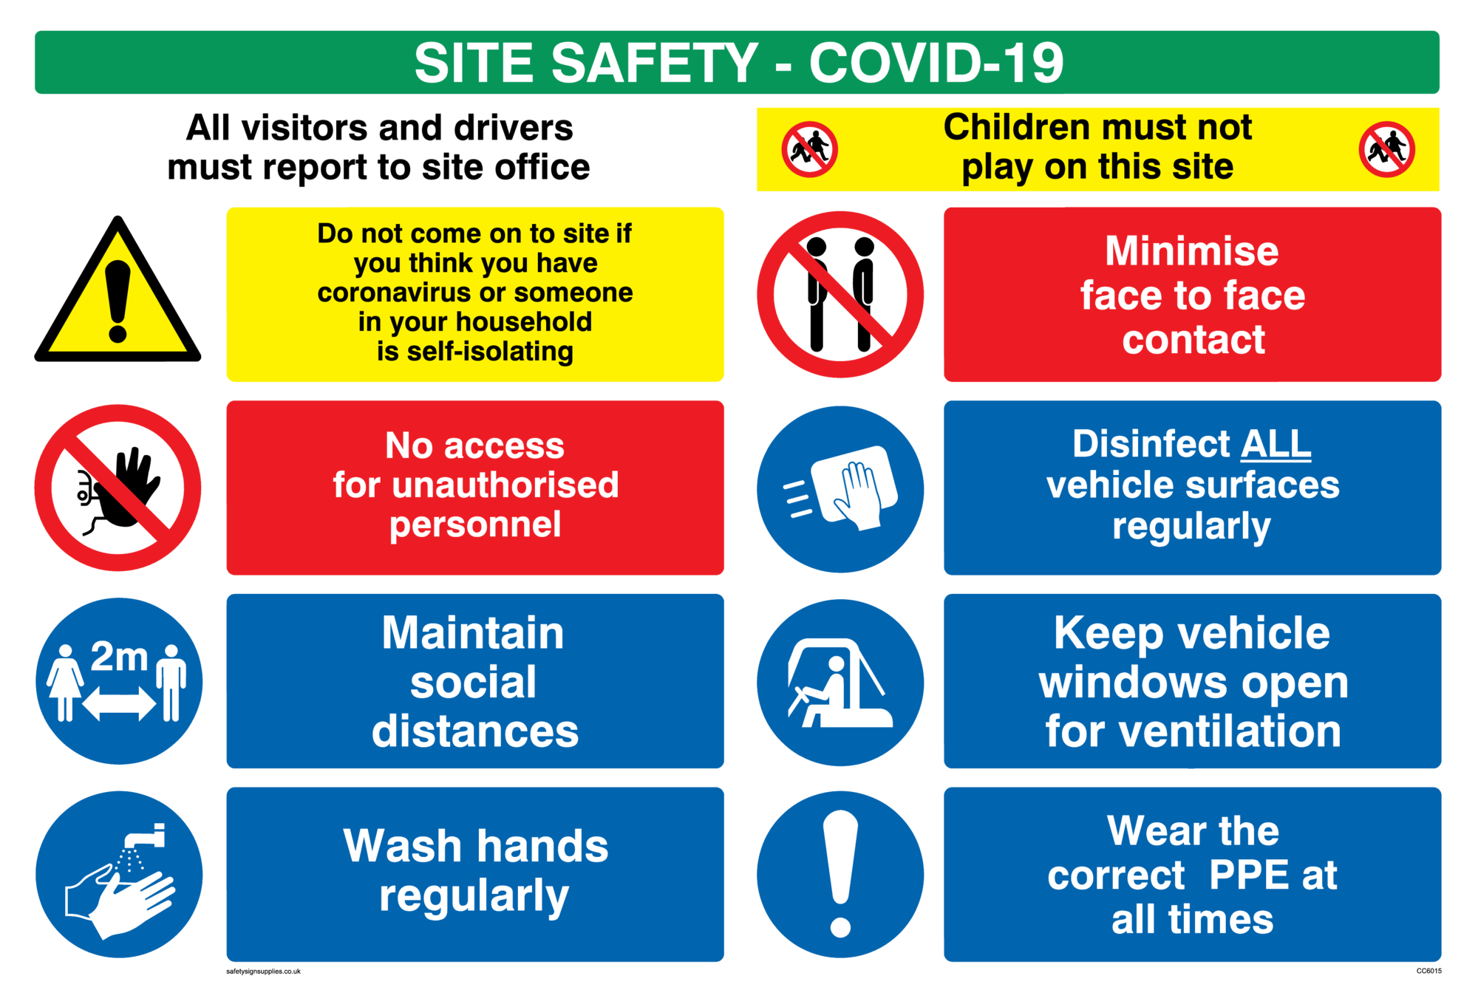

Slide 71
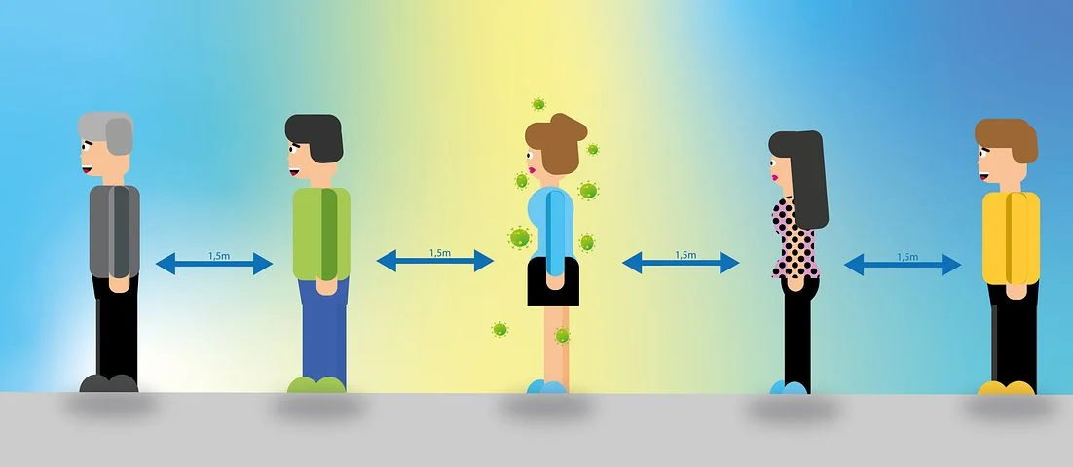

Slide 72
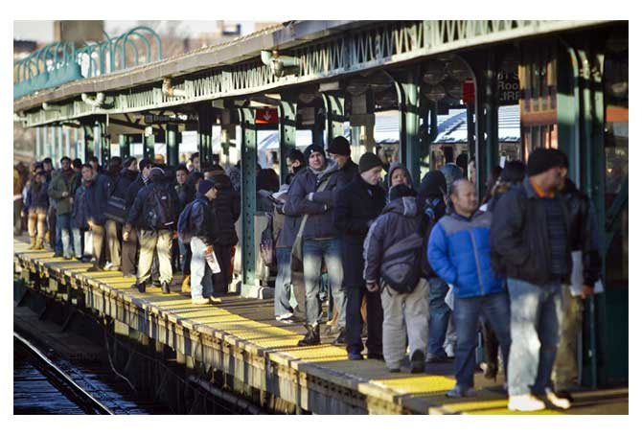

Slide 73
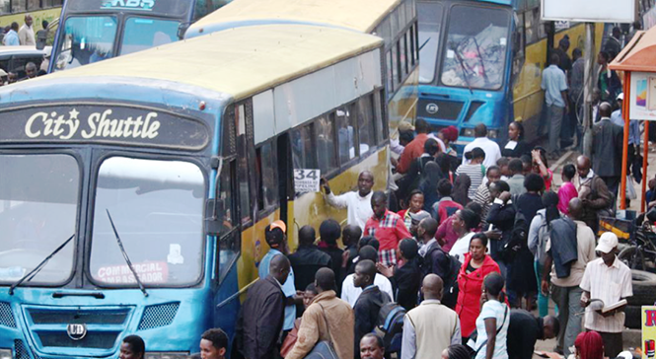

Slide 74

Car Pooling

Slide 75
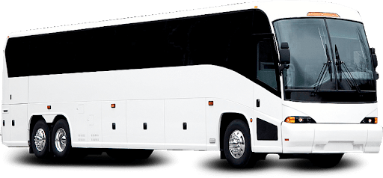
Your Co.

Slide 76
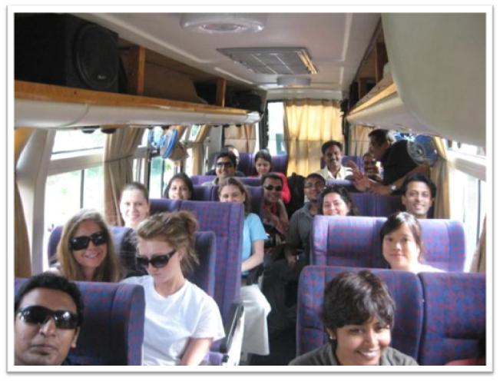

Slide 77

Bldg Reception? Your Reception?

Slide 78
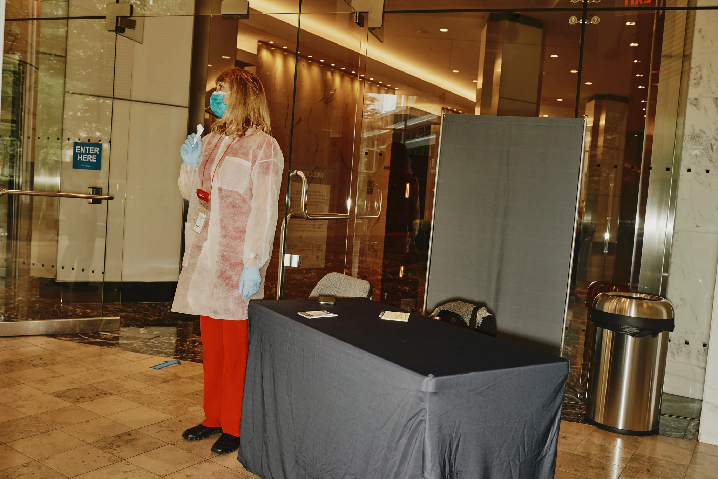

Slide 79
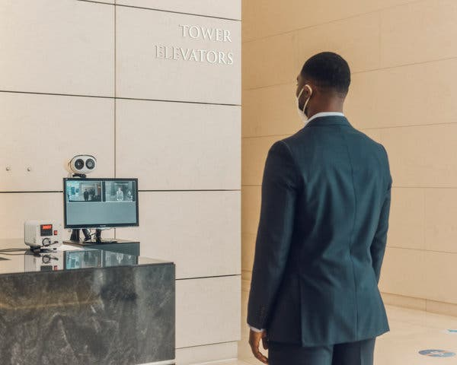
Temperature
Testing
Widespread

Slide 80
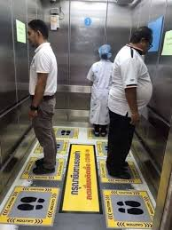

Slide 81
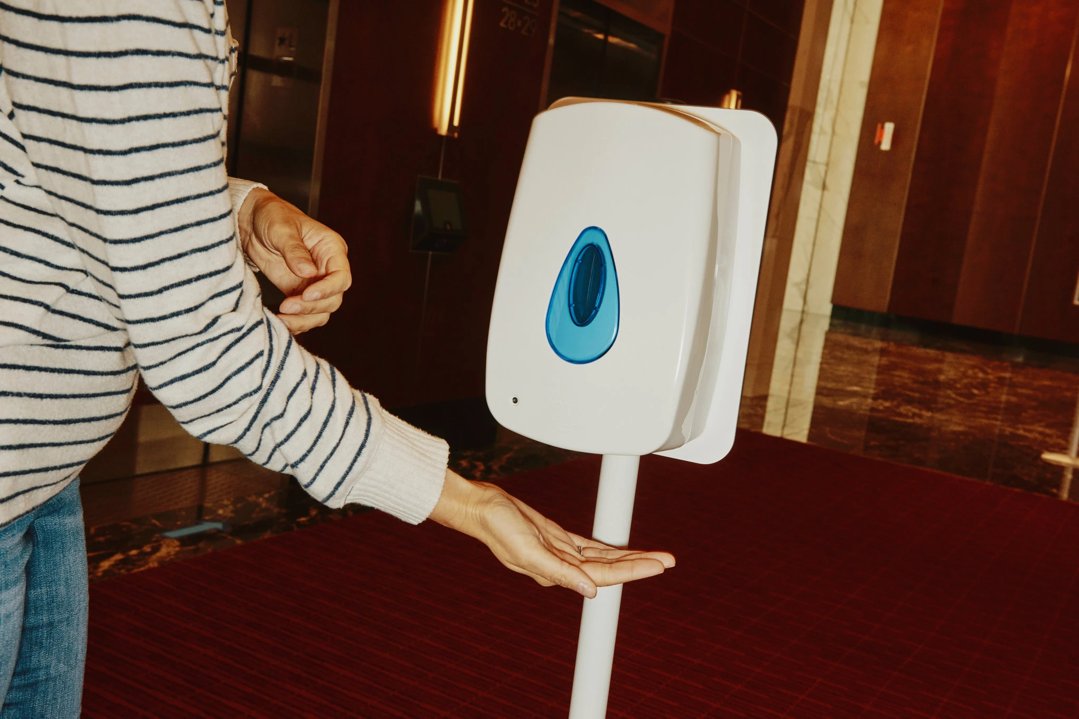

Slide 83
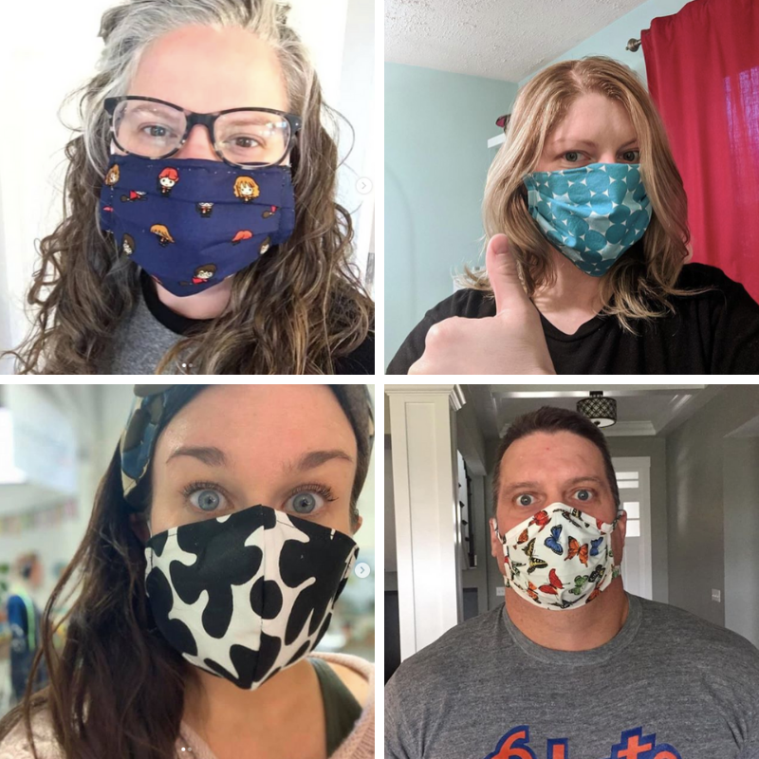
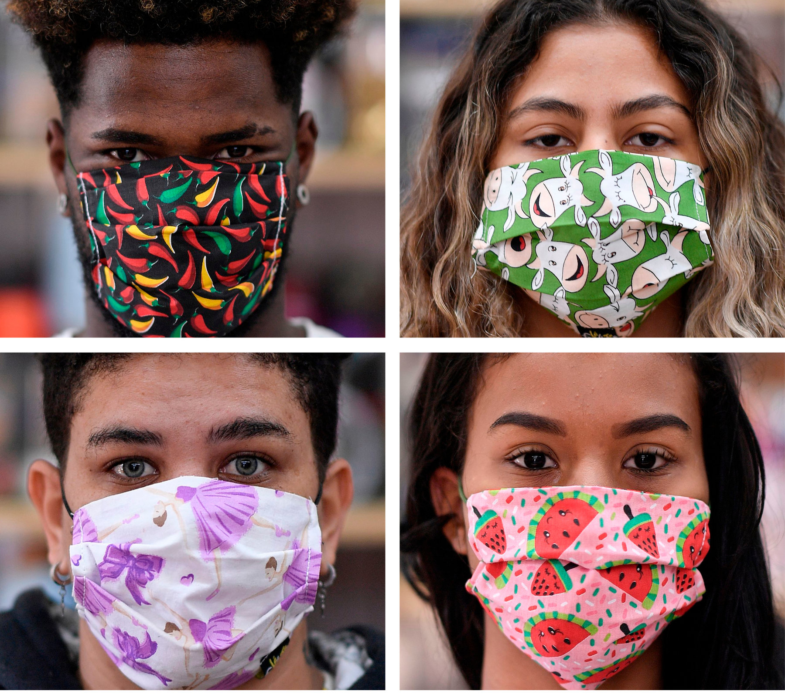

Slide 84
OK!

Slide 85
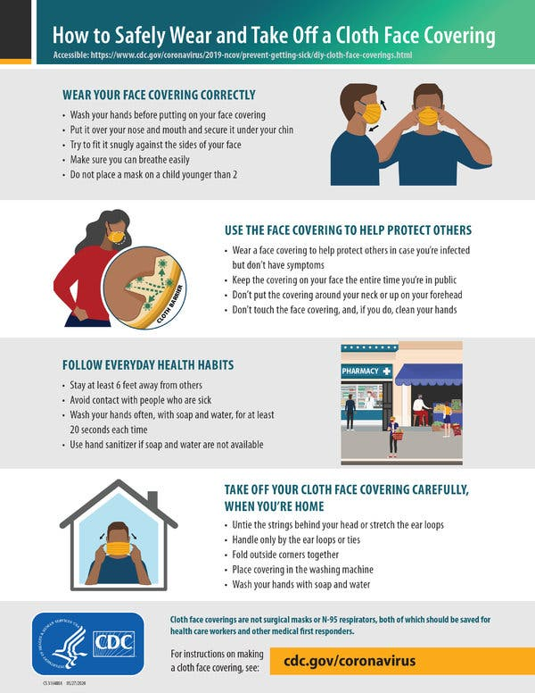
Is It Employer’s Requirement for Employees
Issue
No Cost?

Slide 86
Is It Employer’s Requirement to Train Employees on
How to Fit?

Slide 87
Is It Employer’s Requirement to Train Employees on How to Fit?
How to Use?

Slide 88
Is It Employer’s Requirement to Train Employees on How to Fit? How to Use?
How to Clean + Maintain?

Slide 89
Is It Employer’s Requirement to Train Employees on How to Fit? How to Use? How to Clean + Maintain?
How to Dispose?

Slide 90
Is It Employer’s Requirement to Train Employees on How to Fit? How to Use? How to Clean + Maintain? How to Dispose?
How to Replace?

Slide 91

Replace at No Cost?
Is It Employer’s Requirement to Train Employees on How to Fit? How to Use? How to Clean + Maintain? How to Dispose? How to Replace?

Slide 92
Is It Employer’s Requirement to Train Employees on How to Fit? How to Use? How to Clean + Maintain? How to Dispose? How to Replace?
Yes!

Slide 93

29 CFR 1910.132
Yes!

Slide 94
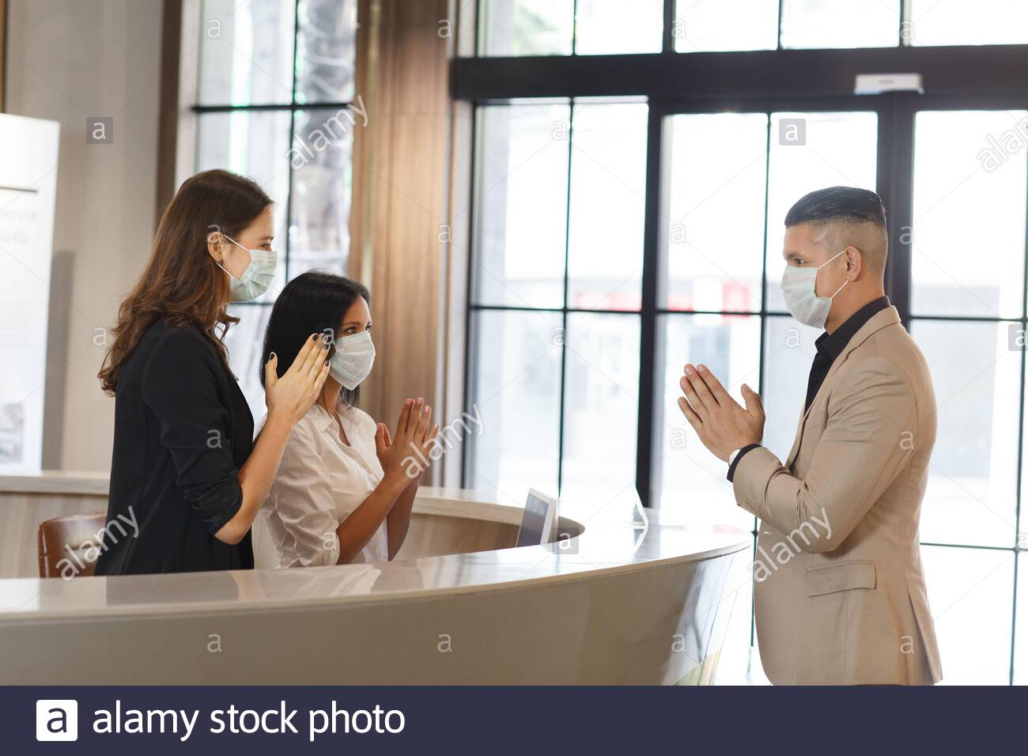
Visitors?

Slide 96
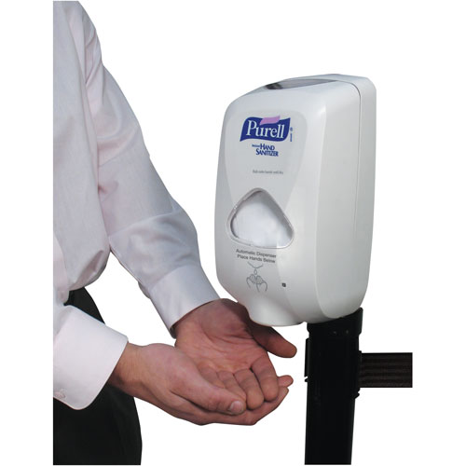
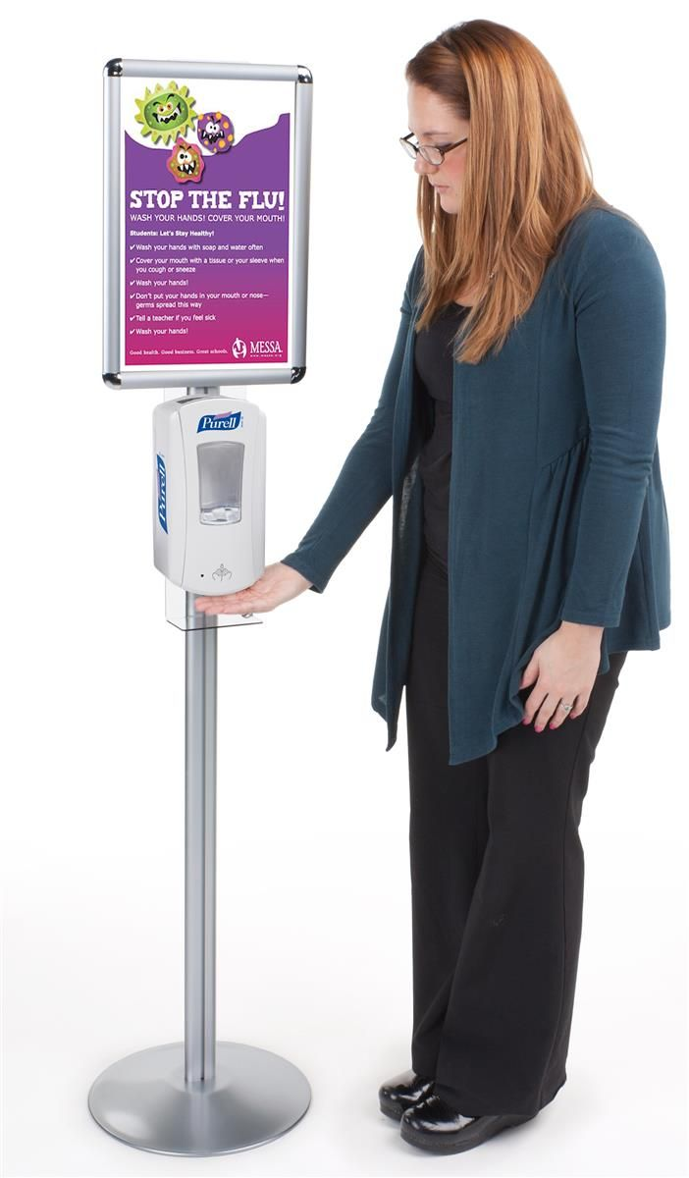

Slide 97
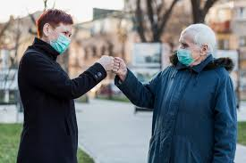

Slide 98


Slide 99
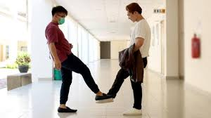

Slide 100
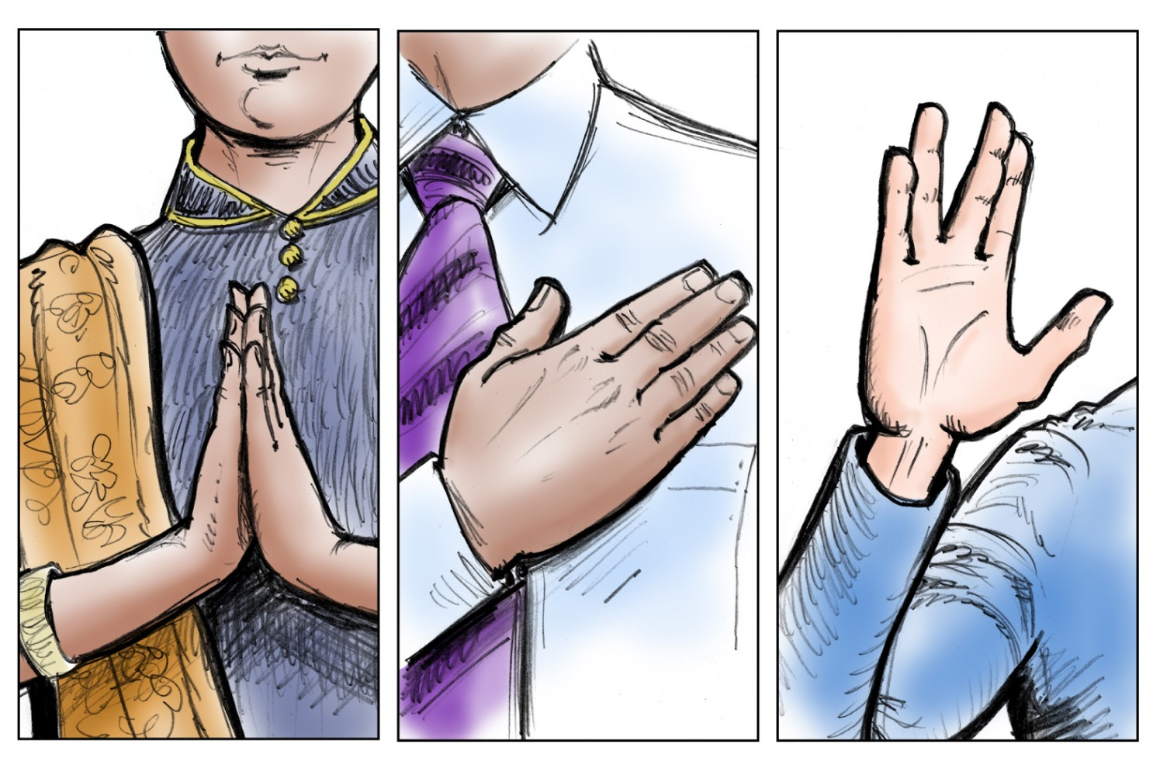
✓

Slide 101
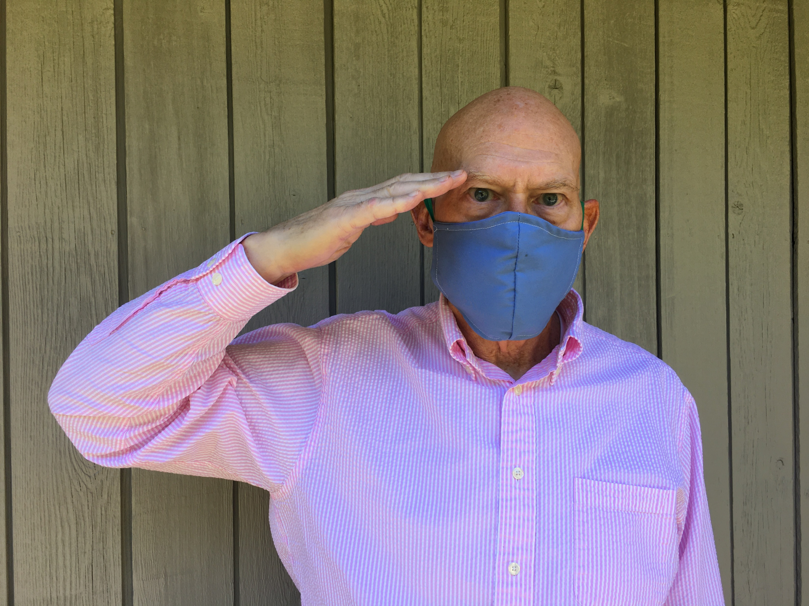
✓

Slide 102
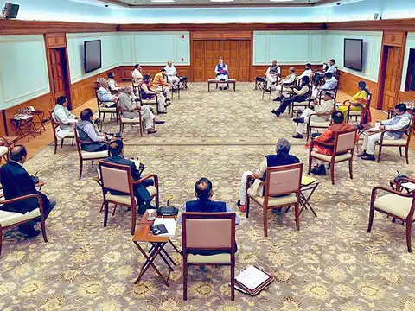

Slide 103
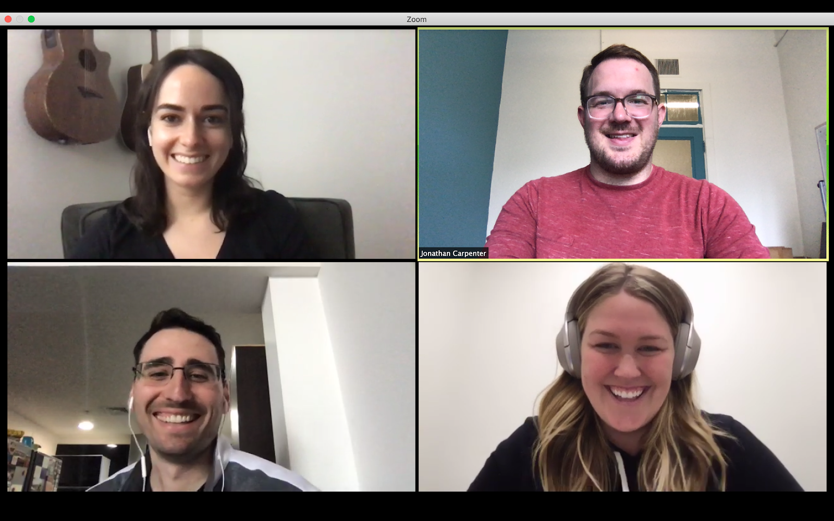

Slide 104
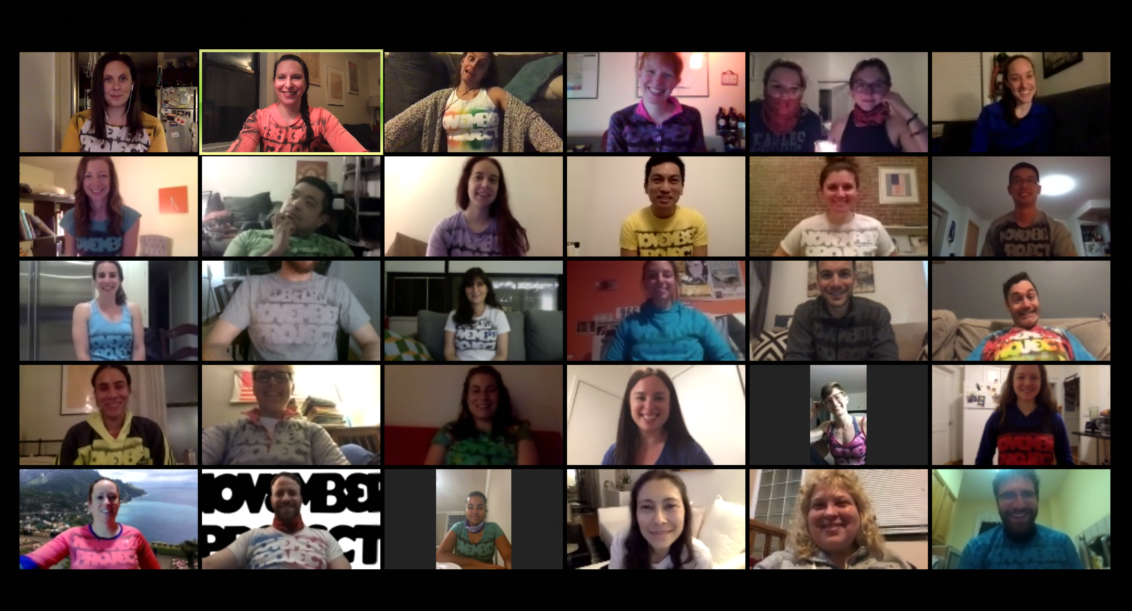

Slide 105
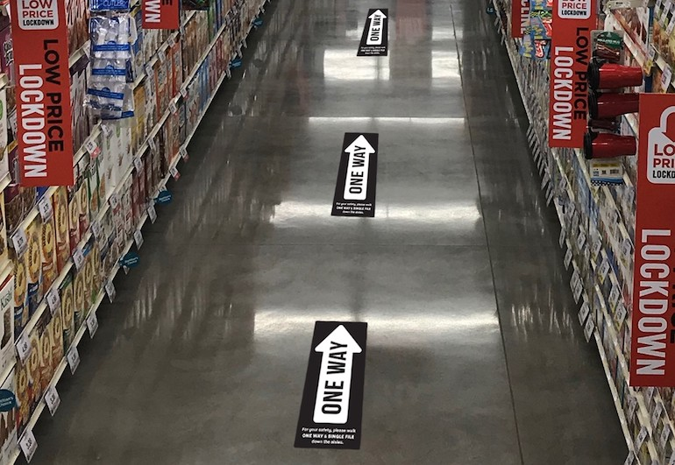

Slide 106
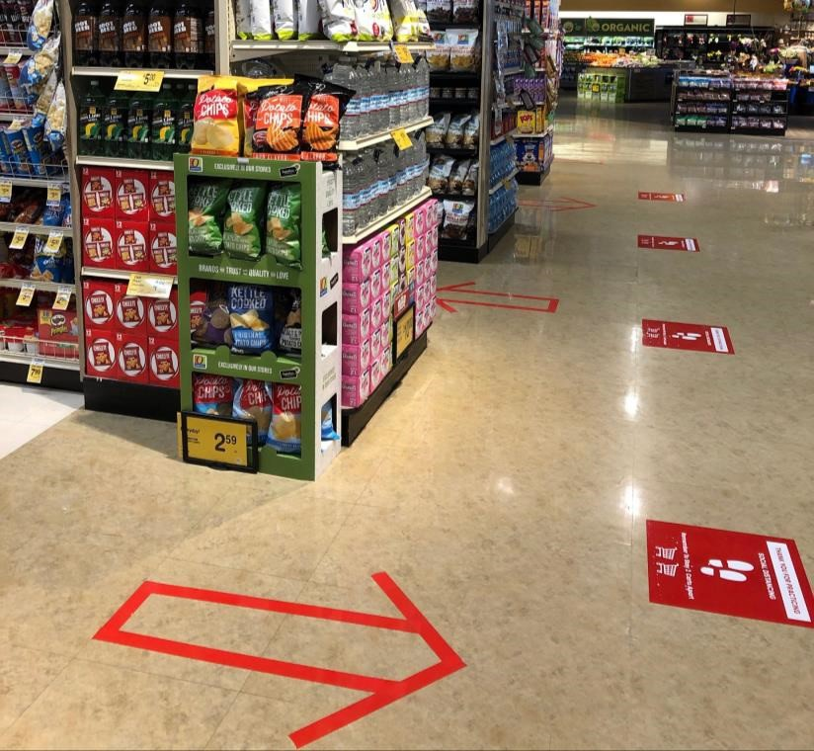

Slide 107
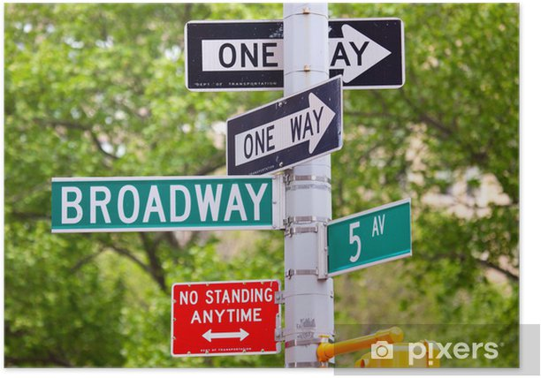

Slide 108
RTW: Physical
Procedures
WFH RTW
Phased RTW
WFH RTW Together
Signage
Distancing
Commuting
Access Control
Temperature Testing
Masks: Usage, etc.
Visitors
Hand Hygiene
Salutations
Meetings
Vectoring

Slide 109
RTW: Physical Procedures
RUOK?
WFH RTW
Phased RTW
WFH RTW Together
Signage
Distancing
Commuting
Access Control
Temperature Testing
Masks: Usage, etc.
Visitors
Hand Hygiene
Salutations
Meetings
Vectoring

Slide 111


Slide 112
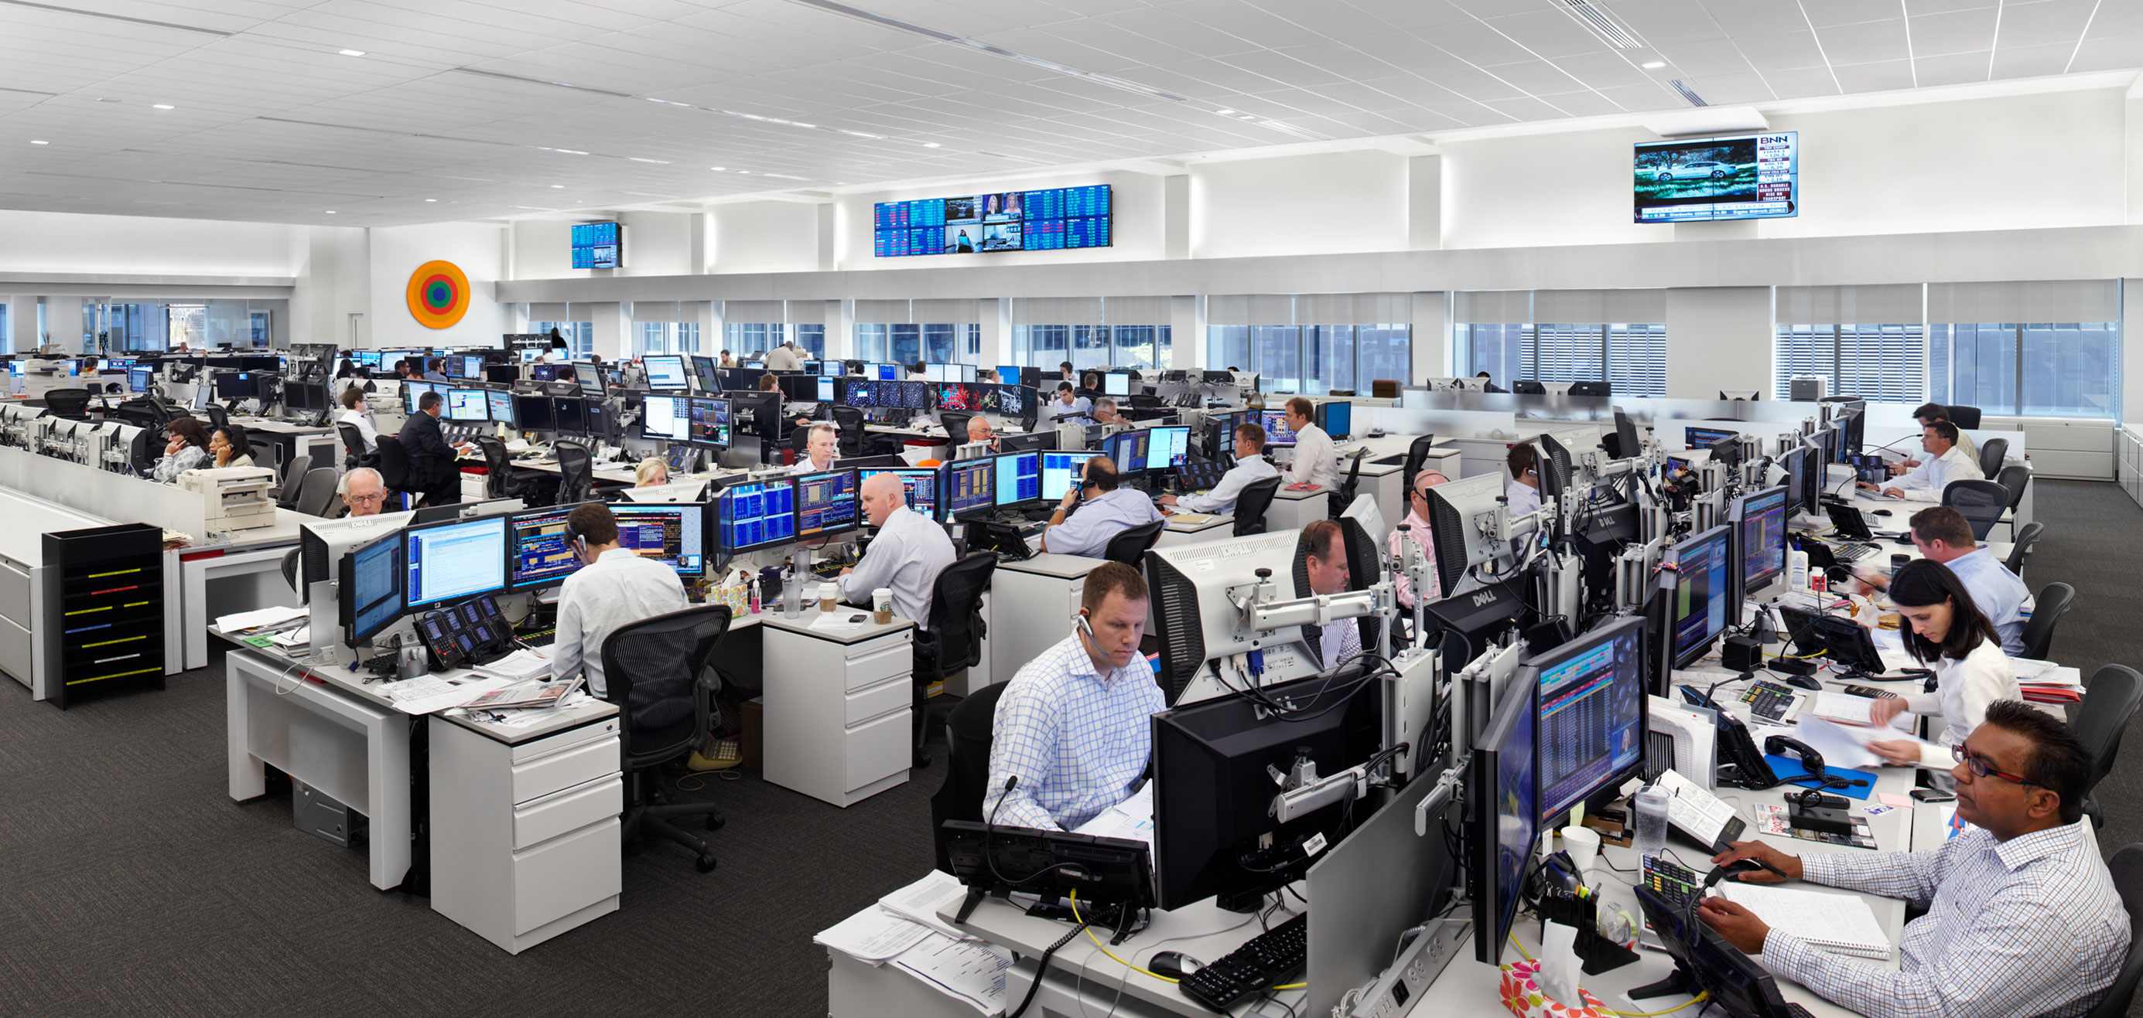

Slide 113
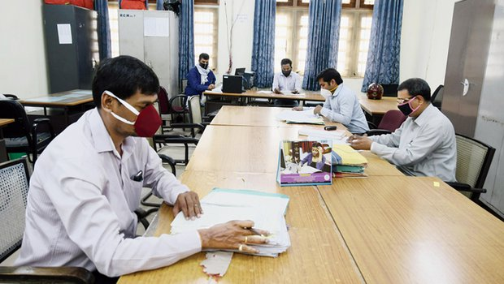

Slide 116
Recon-figure
Your Space?

Slide 117
Recon-figure
Your Space?

Slide 118
Recon-figure
Your Space?
Trigger
For
Training

Slide 119
Recon-figure
Your Space?
Required
By Law
Training

Slide 120

Your

Slide 121

Mandatory
    29 CFR 1910.38/.39
      Emergency Action Plan
      Fire Prevention Plan

Slide 122
Mandatory
Mandatory
Every
Employer
In U.S.
    29 CFR 1910.38/.39
      Emergency Action Plan
      Fire Prevention Plan

Slide 123
Mandatory
Standards
= Platform
    29 CFR 1910.38/.39
      Emergency Action Plan
      Fire Prevention Plan

Slide 124
Duty of Care

Slide 125
Duty of Care Affirmative

Slide 126
General Duty
Clause
“each employer shall
furnish …a place of employment…free from recognized hazards that are causing or are likely to cause death or serious physical harm to employees.”

Slide 127
Today’s Goal
Leaders
Protect Their Employees

Slide 128
Today’s Goal
Build Authority + Confidence Employees, Directors, Customers

Slide 129
1600

Slide 131
Standards
= Platform

Slide 132
Shall Create + Train Plans
All
Hazards
1600

Slide 133

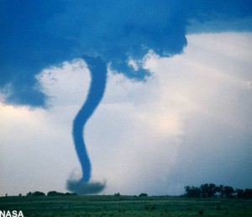

Slide 134
All-Hazards Plan: Shall
Emergency Team
Chain of Command
Visitors
Contractors
Civil Disturbance
Special Needs
Headcounts
Evacuation
In-Building Relo
AAs
Fire
Bomb Threat
Medical Em
Security
Active Shooter
Hostage
Lockout
Suicide
Bullying
Perimeter Access
Security Aft Hours
Chemical Spill: In
Chemical Spill: Out
Shelter in Place
Suspicious Pkg
Suspicious Person
Explosion
Structural Failure
Severe Weather
Elevator Em
Power Outage
Water/Phone Out
Lockdown
Air Quality
Em Shutdown
Earthquake
Flooding
Pipe Burst
CBRNE
Terrorism
Use of FEs
Training
Drills
Exercises
Search-Seizure
Weapons
Evac Maps
Em Contacts
Pandemic: COVID 19
1600

Slide 135
Your Plan???
Fire
Evacuation
Headcounts
Bomb
Chem Spill
Drills
Weather
Sus Pkg
Sus Pers
Pwr Out

Slide 136
All-Hazards Plan: Shall
Emergency Team
Chain of Command
Visitors
Contractors
Civil Disturbance
Special Needs
Headcounts
Evacuation
In-Building Relo
AAs
Fire
Bomb Threat
Medical Em
Security
Active Shooter
Hostage
Lockout
Suicide
Bullying
Perimeter Access
Security Aft Hours
Chemical Spill: In
Chemical Spill: Out
Shelter in Place
Suspicious Pkg
Suspicious Person
Explosion
Structural Failure
Severe Weather
Elevator Em
Power Outage
Water/Phone Out
Lockdown
Air Quality
Em Shutdown
Earthquake
Flooding
Pipe Burst
CBRNE
Terrorism
Use of FEs
Training
Drills
Exercises
Search-Seizure
Weapons
Evac Maps
Em Contacts
Pandemic: COVID 19
1600

Slide 137
You?

Slide 138
1,000+
Emergency Plans Reviewed

Slide 139
Compliant?

Slide 140
Compliant?
1

Slide 141

3
Things Guaranteed
in Life

Slide 142
3 Things in Life Guaranteed
Death

Slide 143
3 Things in Life Guaranteed
Death
Taxes

Slide 144
3 Things in Life Guaranteed
Death
Taxes
You Do Not Have: EAP Complies w
1600

Slide 145
Landlord?

Slide 146

Emergency Plans? Training?
Go Away!

Slide 147
Landlord Has No Obligation re Tenant Employer Requirements: Emergency Planning or Training in Federal, State or Local Law.

Slide 148

4
Things Guaranteed in Life

Slide 149
4 Things in Life Guaranteed
Death

Slide 150
4 Things in Life Guaranteed
Death
Taxes

Slide 151
3 Things in Life Guaranteed
Death
Taxes
You Do Not Have: EAP Complies w
1600

Slide 152
4 Things in Life Guaranteed
Death
Taxes
You Don’t Have: EAP
Your Landlord Does NOT Have: EAP Complies w
1600

Slide 153
All-Hazards Plan: Shall
Emergency Team
Chain of Command
Visitors
Contractors
Civil Disturbance
Special Needs
Headcounts
Evacuation
In-Building Relo
AAs
Fire
Bomb Threat
Medical Em
Security
Active Shooter
Hostage
Lockout
Suicide
Bullying
Perimeter Access
Security Aft Hours
Chemical Spill: In
Chemical Spill: Out
Shelter in Place
Suspicious Pkg
Suspicious Person
Explosion
Structural Failure
Severe Weather
Elevator Em
Power Outage
Water/Phone Out
Lockdown
Air Quality
Em Shutdown
Earthquake
Flooding
Pipe Burst
CBRNE
Terrorism
Use of FEs
Training
Drills
Exercises
Search-Seizure
Weapons
Evac Maps
Em Contacts
Pandemic: COVID 19
1600

Slide 154
The Virus
Ate My Emergency Plan…

Slide 155
The Virus
Ate
My Emergency Plan…Your Honor.

Slide 156
You?

Slide 157
Employee Refuse: RTW?
Laws: Maybe No…Maybe Yes…
ADA Could Be in Play: Underlying Conditions
Your Decision Critical to Your Employees’ Health
Critical to Overall Morale
Get Your General Counsel to Rule

Slide 158
Can Gov’t Legally Force You + Yours to Wear a Mask?
Yes

Slide 159
Employee Refuse Masks: RTW?
Laws: No…but…
ADA Could Be in Play: Underlying Conditions
Your Decision Critical to Your Employees’ Health
Critical to Overall Morale
Get Your General Counsel to Rule

Slide 160
Require/Ask Employees to sign a Coronavirus Liability Waiver?
Sure…but…
Most Courts Will Not Rule in Your Favor
If Negligent re: Safety, Waiver Is Null
Not an Effective Way to Say “You Must Wear a Mask Unless You Sign Waiver.”

Slide 161
Threats to Your Workplace

Slide 162
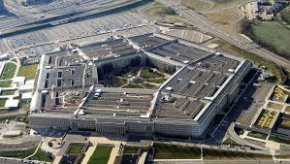

Slide 163
Always Fighting the Last War

Slide 164

Threats
4.1 MM
Workplace Injuries
Annually
DOJ

Slide 165
Threats
5,100
Workplace
Deaths
OSHA

Slide 166
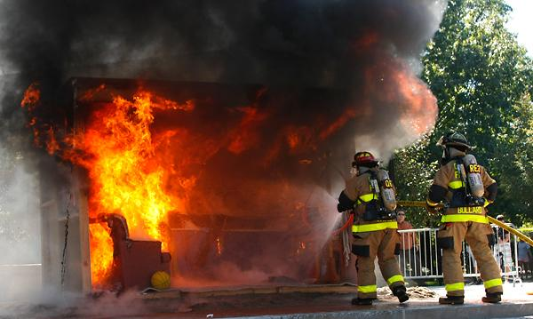
111,500 Structural Fires at Work:

Slide 167
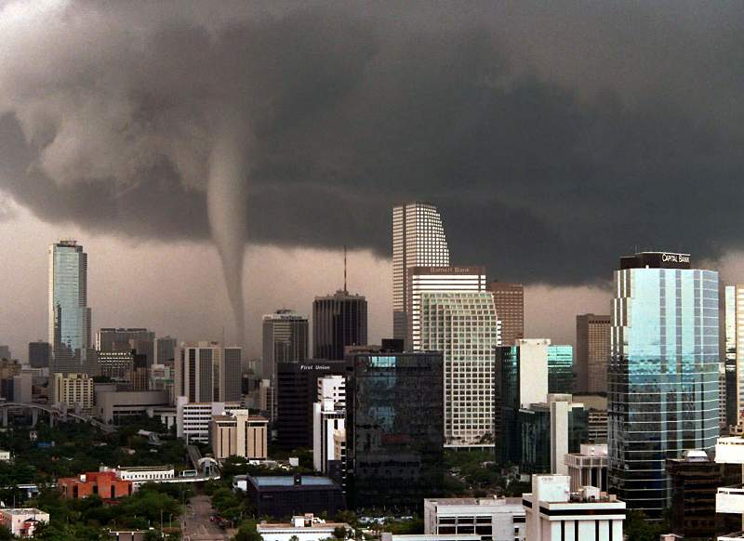

Slide 168


Slide 169
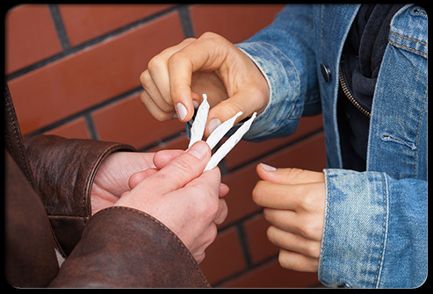

Slide 170


Slide 171


Slide 172
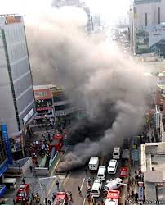

Slide 173


Slide 174
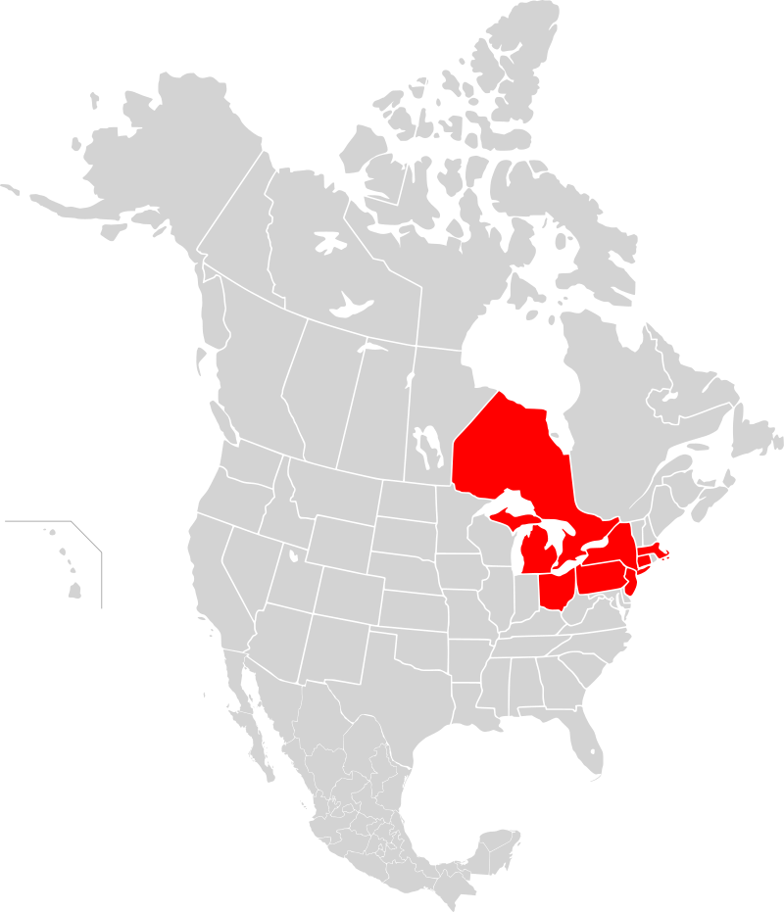
14 Aug 2003

Slide 175
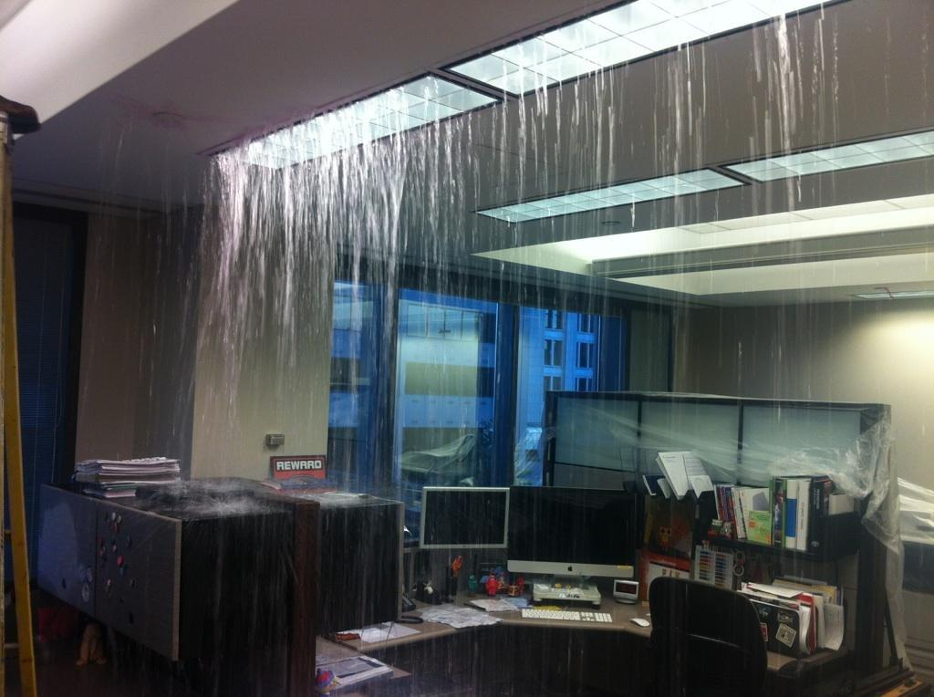

Slide 176
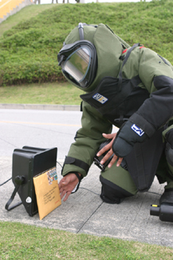

Slide 177
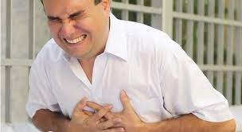

10,000: Work

Slide 178
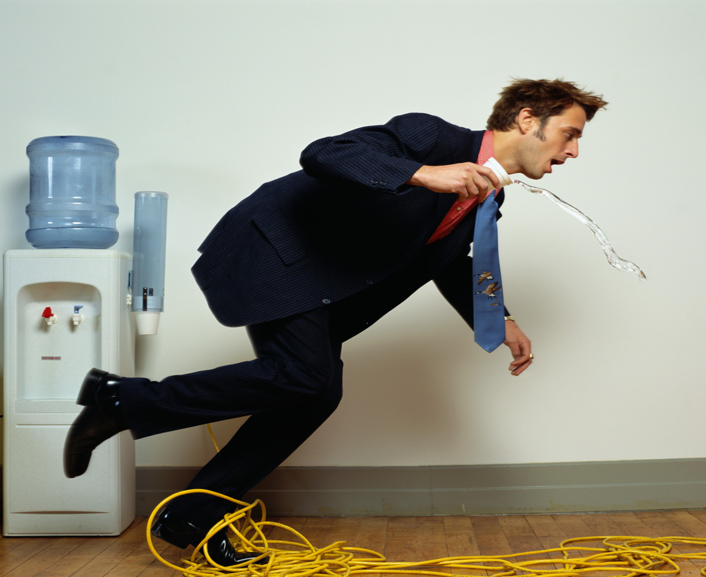
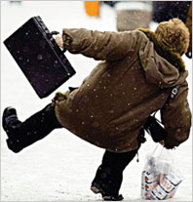

Slide 179
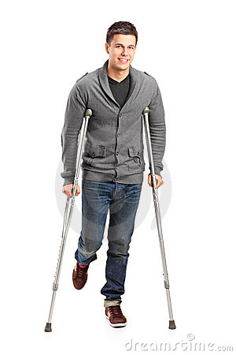
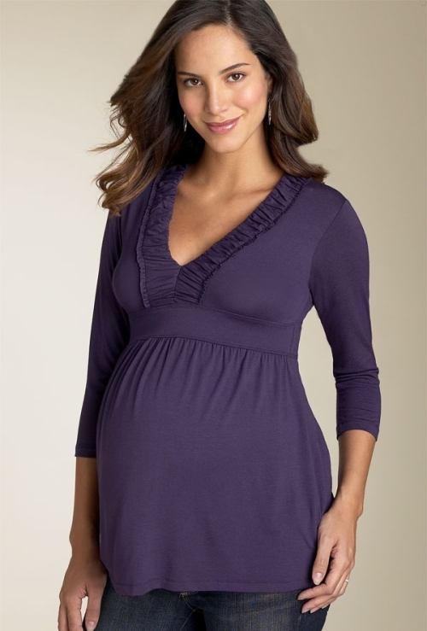
Special
Needs
Persons

Slide 180


Slide 181
COVID
19
Special
Needs
Persons

Slide 182
Out of
Date
2019

Slide 184
Evacuation Maps
Required by Law
Must be for Every Employee from Any/All Parts
of Every Building

Slide 185
Evacuation Maps
29 CFR 1910.38
29 CFR 1910.36
29 CFR 1910.37

Slide 186
Great
plans are a smart thing…

Slide 187
Great plans are a
smart thing…
Training is
everything

Slide 188
Training: The Law
Mandatory
Train All Employees
In Classroom
Annually & At Hire
“Qualified” Trainer
(by Experience, Training)

Slide 189
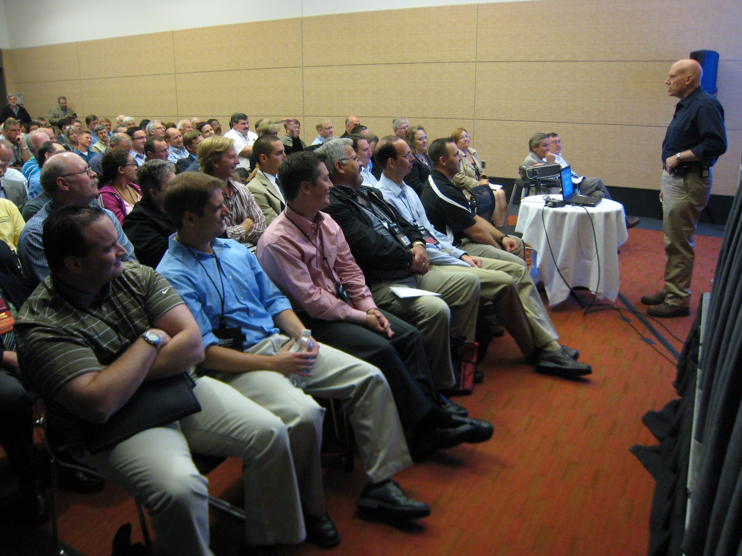

Slide 190

On-Screen Training
Can Supplement

Slide 191
On-Screen Training
Can NEVER
Substitute

Slide 192

OK
During
COVID 19
On-Screen Training Can Supplement

Slide 193
Employees
Hate This
Stuff!

Slide 194

National Research
85%
Safety:
MOST Important
Issue at Work

Slide 195
National Research
85%
Safety: MOST Important Issue at Work
More Imp than:
        Wages
        Leave
        Sick Days
        Overtime
        Union

Slide 196
Training
Guarantee

Slide 197
Training Promise
You Give Me
Your Emps
3 hrs Annually

Slide 198
Training Promise
I’ll Give You Back
Your Emps Confident They Can Respond to Any Emergency

Slide 199
Training
Trained 36,000 Employees

Slide 200
Training
Trained 36,000 Employees
98.5%
Confident

Slide 201
98.5% Confident
Made It All About THEM

Slide 202
98.5% Confident
Took “Scary” out of Discussion

Slide 203
98.5% Confident
Made Everyone Comfortable

Slide 204
98.5% Confident
All Empowered

Slide 205
RTW

Slide 206


Slide 207


Slide 208
WFH
You Ordered them WFH 1Apr20

Slide 209
No
Break
WFH
You Ordered them WFH 1Apr20

Slide 210
2 Jan 21
276 Days

Slide 211
276 Days in Potentially Lethal
Conditions

Slide 212
276 Days in Potentially Lethal
Conditions
Where the Virus Could Strike

Slide 213
276 Days in Potentially Lethal
Conditions
Where the Virus Could Strike Themselves or Family

Slide 214

In-Combat Rotation: 30 days

Slide 215
In- Combat Rotation: 30 days Then 15 Days R+R

Slide 216
You’re Sending Them Back to Work in 276 Days with No Break

Slide 217
And the Lethal Threat Is Still Ready to Strike

Slide 218
And the Lethal Threat Is Still Ready to Strike at Work + at Home

Slide 219
6 Mos? 12Mos? 18Mos?

Slide 220
What Should You Look For re: Emotional Impact on Your Employees?

Slide 221
Stress
Work
Family/School
Commuting
2nd Wave
Another Quarantine
Family Income

Slide 222
1Apr20
No Break
Stress
Work
Family/School
Commuting
2nd Wave
Another Quarantine
Family Income

Slide 223




Slide 224


Slide 225

Drug Overdoses
20%

Slide 226
Drug Overdoses
During
COVID 19
20%

Slide 227



Slide 228

During
COVID 19
Booze 55%
Tequila, Gin 75%
Wine 66%
Beer 42%

Slide 229

U.S.
DivorceFilings
30%
.
U.S.
DivorceFilings

Slide 230
DivorceFilings
During
COVID 19
U.S.
+30%
.
Divorce
Filings

Slide 231



Slide 232


Slide 233
6 Mos? 12Mos? 18Mos?

Slide 234
COD: U.S. 2018
Auto Deaths: 40,000
Gun Deaths: 39,773

Slide 235
COD: U.S. 2018
Auto Deaths: 40,000
Gun Deaths: 39,773
Suicides: 48,344

Slide 236



Calls: Suicide Lifeline
Apr ‘19: 1,790

Slide 237
Calls: Suicide Lifeline
Apr ‘19: 1,790
Apr ‘20: 20,000

Slide 238
Suicides: U.S. 2018
Highest in middle-aged white men.
Average: 132 suicides per day.
White males = 69.67% of suicides
Firearms = 50.57% of all suicide deaths.

Slide 239

8 of 10 Corporate Executives
have experienced poor mental health during the coronavirus crisis, prompting a number of them to re-evaluate and improve work-life balance.

Slide 240

Reports Suicides
30%
U.S. Military Reports Suicides

Slide 241
During
COVID 19
Reports Suicides
30%
U.S. Military Reports Suicides

Slide 242
Considered Suicide
During COVID19
10% All US Adults
30% w/o HS Diploma
13% w HS Diploma
44% of PTSD
30% Unpaid Caregivers

Slide 243

Overall Stress + Depression
53% + emotionally exhausted
53% + feeling of sadness in day-to-day life
50% + irritable
42% + confused
38% + insomnia
32% + anger
24% + feelings of guilt

Slide 244

Overall Stress + Depression
Per-day # of anxiety screens +535% Aug v. Jan
Per-day # of depression screens +709%
Aug v. Jan

Slide 245

988
National Suicide
Prevention Lifeline
Authorized
16 July 2020

Slide 246
Warning Signs
Employees Who May Become
Suicidal
Excessive sadness or moodiness
Sudden calmness
Withdrawal
Changes in personality and/or appearance
Dangerous or self-harmful behavior
Recent trauma or life crisis
Making preparations
Threatening suicide

Slide 247
Warning Signs
Employees Who May Become Suicidal
Train
Your
Employees
Excessive sadness or moodiness
Sudden calmness
Withdrawal
Changes in personality and/or appearance
Dangerous or self-harmful behavior
Recent trauma or life crisis
Making preparations
Threatening suicide

Slide 248

Threats
2 million
Workplace Violence
Annually
DOJ

Slide 249
Facts: WPV
2 people murdered/day!
Every hour:
      26 rapes
      44 robberies
      207 aggravated assaults
      938 simple assaults
      3,125 threats

Slide 250
18x
More Likely to Have
Violence than a Fire
at Work
DOJ & NFPA

Slide 251

Intimate Partner
Violence

Slide 252


Intimate Partner
Violence Kills
1,300 Every Year

Slide 253

2 Workplace Homicides Every Day

Slide 254

Workplace Bullying

Slide 255

Every A.S. Has Been Bullied: ✓School
✓Work ✓Neighborhood

Slide 256


23%
Murder Rate:
Top 23 U.S. Cities
Thru 7/2020
vs Yr. Ago

Slide 257
Murder Rate: Top 23 U.S. Cities
During
COVID 19
23%
Thru 7/2020
vs Yr. Ago

Slide 258

300%
Guns Seized at
Airports
7/20
vs 7/19

Slide 259
Guns Seized at Airports
During
COVID 19
300%
7/20
vs 7/19

Slide 260
Stress
Work
Family/School
Commuting
2nd Wave
Another Quarantine
Family Income

Slide 261
Yellow Flags Employees
Who May Become Violent
Fascination w weapons/incidents of violence
General narcissistic attitude
Disruptive outbursts or temper flare-ups disproportional to source of agitation
Consistent attempts to argue against co-workers
Tendency to interpret daily events in a morbid or pernicious way
Consistent display of "victim-syndrome"
Controlling or demanding personality
General tendency to make
co-workers uncomfortable
Proponent of general and "inter-office" conspiracy theories
Multiple gun ownership
Consistent complaints, negative comments, or consistently filing grievances
Persistent, inappropriate anger
Affiliation with fringe, anti-government, or racist organizations
Indications of drug or alcohol abuse

Slide 262
Yellow Flags
Employees Who May Become Violent
Train
Your
Employees
Fascination w weapons/incidents of violence
General narcissistic attitude
Disruptive outbursts or temper flare-ups disproportional to source of agitation
Consistent attempts to argue against co-workers
Tendency to interpret daily events in a morbid or pernicious way
Consistent display of "victim-syndrome"
Controlling or demanding personality
General tendency to make co-workers uncomfortable
Proponent of general and "inter-office" conspiracy theories
Multiple gun ownership
Consistent complaints, negative comments, or consistently filing grievances
Persistent, inappropriate anger
Affiliation with fringe, anti-government, or racist organizations
Indications of drug or alcohol abuse

Slide 263
Red Flags Employees Who
May Become Violent
Suffers what the individual considers a profound, public humiliation
Passed over for promotion
Individual makes critical mistake that negatively affects the company
Individual is publicly reprimanded
Individual is teased or otherwise harassed
Individual is fired,
laid-off, "downsized"
Personal life trauma resulting in a feeling of helplessness
Divorce, separation
Death of spouse, family member
Dramatic increase in anxiety, anger, depression (swift, observable mood swing)

Slide 264
Red Flags
Employees Who May Become Violent
Train
Your
Employees
Suffers what the individual considers a profound, public humiliation
Passed over for promotion
Individual makes critical mistake that negatively affects the company
Individual is publicly reprimanded
Individual is teased or otherwise harassed
Individual is fired, laid-off, "downsized"
Personal life trauma resulting in a feeling of helplessness
Divorce, separation
Death of spouse, family member
Dramatic increase in anxiety, anger, depression (swift, observable mood swing)

Slide 265
6 Mos? 12Mos? 18Mos?

Slide 266
All-Hazards Plan: Shall
Emergency Team
Chain of Command
Visitors
Contractors
Civil Disturbance
Special Needs
Headcounts
Evacuation
In-Building Relo
AAs
Fire
Bomb Threat
Medical Em
Security
Active Shooter
Hostage
Lockout
Suicide
Bullying
Perimeter Access
Security Aft Hours
Chemical Spill: In
Chemical Spill: Out
Shelter in Place
Suspicious Pkg
Suspicious Person
Explosion
Structural Failure
Severe Weather
Elevator Em
Power Outage
Water/Phone Out
Lockdown
Air Quality
Em Shutdown
Earthquake
Flooding
Pipe Burst
CBRNE
Terrorism
Use of FEs
Training
Drills
Exercises
Search-Seizure
Weapons
Evac Maps
Em Contacts
Pandemic: COVID 19
1600

Slide 267
How to Build Your Action Plan for Return to Work

Slide 271
Today’s Goal
Only You Can Create Your Plan + Train Your
Employees

Slide 272
Today’s Goal
Only You Can Create
Your Plan + Train Your Employees:
Site Specific

Slide 273
Today’s Goal
Leaders
Protect Their Employees

Slide 274
Today’s Goal
Build Authority Trust + Confidence: Employees, Directors, Customers

Slide 275
Today’s Goal
We Can
Create +
Train Your
Plan
Only You Can Create Your Plan + Train Your Employees:
Site Specific

Slide 276
Help for You
Right Now

Slide 277
Help For You
Now
A Copy of This Presentation

Slide 278
Help For You
Now
A Copy of This Presentation
WFH Safety Checklist

Slide 279
Help For You
Now
A Copy of This Presentation
WFH Safety Checklist
10 Commandments of Emergency Planning for Employers

Slide 280
Help For You
Now
A Copy of This Presentation
WFH Safety Checklist
10 Commandments of Emergency Planning for Employers
10 Commandments of Employee Training for Your Workplace

Slide 281
Help For You
Now
A Copy of This Presentation
WFH Safety Checklist
10 Commandments of Emergency Planning for Employers
10 Commandments of Employee Training for Your Workplace
RTW Checklist

Slide 282
Help For You Now
Free
A Copy of This Presentation
WFH Safety Checklist
10 Commandments of Emergency Planning for Employers
10 Commandments of Employee Training for Your Workplace
RTW Checklist

Slide 283
Help For You Now
911
Consulting
.net
A Copy of This Presentation
WFH Safety Checklist
10 Commandments of Emergency Planning for Employers
10 Commandments of Employee Training for Your Workplace
RTW Checklist

Slide 284
Questions
Bo Mitchell@911Consulting.net
203.563.9999
911Consulting.net

Slide 285
Questions
BoMitchell@911Consulting.net
203.563.9999
Call for Our Free Consultation
Bo Mitchell

Slide 286
Pandemic Planning for Your Workplace
Next Wave

